Slide 1
Classroom Management Series: CHAMPS Data Collection
Presenter:
Shannon Cranford Fields

Slide 2
Take Our Your Electronic Device
Go To www.kahoot.it
Type in the game pin
Enter Your First Name
Get Ready To Play

Slide 3
Give Me A
“C”

Slide 4
C = Conversation

Slide 5
Give Me An “H”

Slide 6
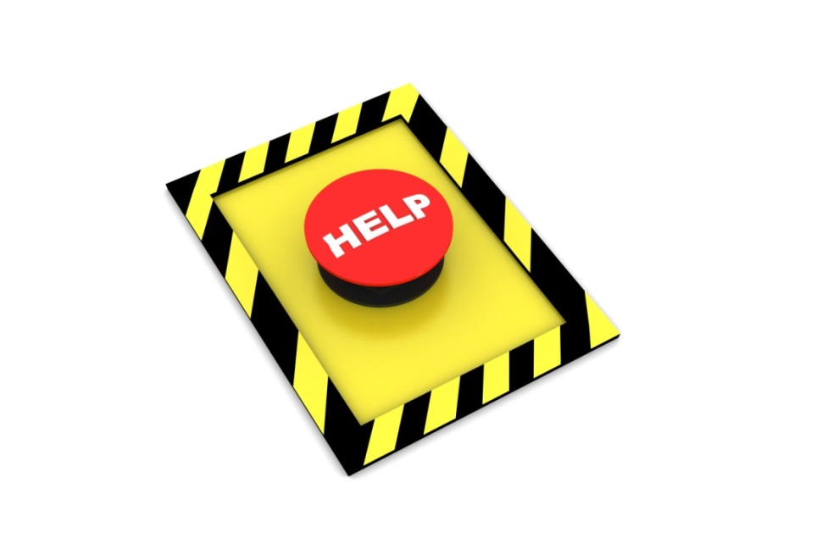
H = Help

Slide 7
Give Me An “A”

Slide 8
A = Activity

Slide 9
Give Me An “M”

Slide 10
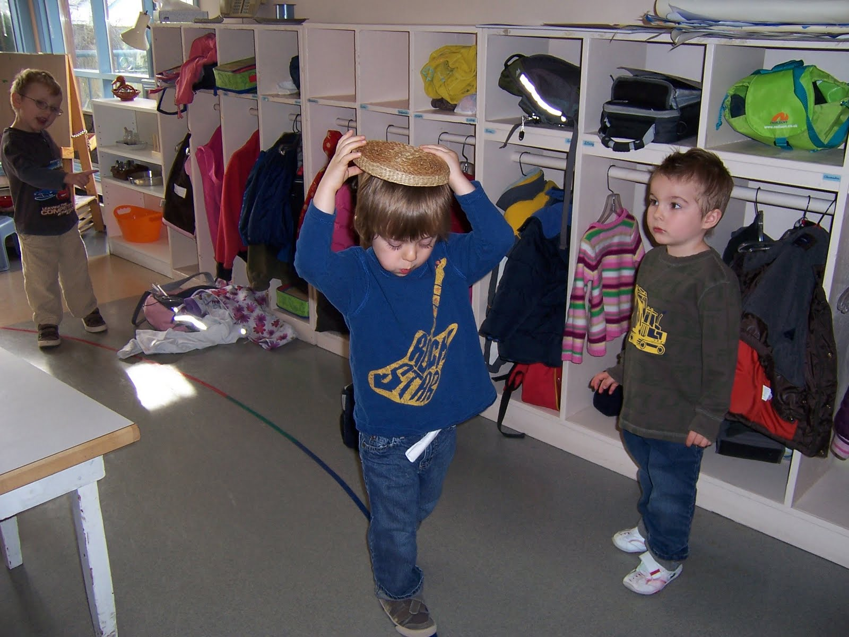
M = Movement

Slide 11
Give Me An “P”

Slide 12
P = Participation

Slide 13
Give Me An “S”

Slide 14
S=Success

Slide 15
S - Structure your classroom for success
T - Teach students how to be successful in your classroom
O - ___________
I - Interact postively
C - Correct fluently

Slide 16
S -
T -
O - Observe student behavior
I -
C -

Slide 17
Why Observe?

Slide 18
The act of observing affects
the behavior of the people
being observed.

Slide 19
Activity
At your tables are post it notes.
Think about your teachers (K-college) and identify the best teacher you ever name isn”t important, why they were the best.
What is one strategy that teacher used for classroom management.
Share out in 5 min.

Slide 20
Two Tasks To Discuss Today
Task 1: Circulate When Possible, and Scan All Sections of the Classroom Continuously.
Task 2: Use Data to Monitor and Adjust Your Classroom Management and Discipline Plan.

Slide 21
Task 1
Circulate When Possible, and Scan All Sections of the Classroom Continuously

Slide 22
Circulating:
Proximity communicates your concern for and interest in the students.
Proximity also communicates you will likely notice misbehavior.
Give positive feedback to students who are meeting your expectations.

Slide 23
Answer questions students may have regarding classwork.
Provide gentle reprimands or consequences to students who are not meeting expectations.
Always try to avoid staying too long in any one place.

Slide 24
Visual Scanning
Always have a clear line of sight to all students.
Visually scan all settings in the classroom frequently.

Slide 25
Auditory Scanning
Listen to all parts of the classroom.
Establish a baseline, or normal level of background noise in your room.

Slide 26
Task 2
Use Data to Monitor and Adjust
Your Classroom Management and Discipline Plan

Slide 27
Task 2 – Tool 1
CHAMPS versus Daily Reality
Rating Scale

Slide 28
Task 2 – Tool 3
Misbehavior Recording
Sheet

Slide 29
Task 2 – Tool 7
Family/Student Satisfaction
Survey

